Slide 1
Finding Payoffs thru the Simulation of Games
By: Mathew Tucker

Slide 2
Conjecture
Since it is possible to model a well defined game with modern computing techniques; then, for a game with indeterminate payoffs, it is possible to calculate the payoffs for some coupling of strategies via a computer models/simulations.

Slide 3
Example
Let us consider the game, “Pursue and Evade,” otherwise known as “Cat and Mouse.”

Slide 4
Cat and Mouse
The rules for “cat and Mouse” are as follows:
  In order for the mouse to win, the mouse must evade capture from the cat.
  In order for the cat to win, the cat must capture the mouse.
  If mouse reaches border, the cat loses and the mouse wins.
  The mouse has the following two strategies:
    Evade
    Stay still
  The cat has the following two strategies:
    Chase
    Stay still
  We should notice, the strategies “Evade” and “Chase” can take many forms. For now we will only consider one form.

Slide 5
“Evade” and “Chase”
The algorithm for “Evade” and “Chase” is as follows:
  Evade
    If the cat is directly above, the mouse can chose to move right, left, or down.
    If the cat is to the left, the mouse can chose to move up, down, or right.
    If the cat is to the left and above, the mouse can chose to move down or right.
    For the opposite cases of the cats relative location, the opposite rules apply to the mouse.
  Chase
    If the cat is directly above, the cat can chose to move right, left, or down.
    If the cat is to the left, the cat can chose to move up, down, or right.
    If the cat is to the left and above, the cat can chose to move down or right.
    For the opposite cases of the cats relative location, the opposite rules apply to the cat.
    We should note the role of anticipation in the cat’s moves.

Slide 6
Strategy Pairs
Payoffs
Stay Still(S.S.) and S.S.
  Cat stays still and mouse moves, cat loses and mouse wins
Chase and S.S.
  Cat chases and mouse stays still, mouse loses and cat wins
S.S. and Evade
  Cat stays still and mouse runs away, cat loses and mouse wins
Chase and Evade
  Cat chases and mouse runs away, indeterminate payoff values as the cat wins “a” portion of the time and the mouse wins “b” portions.

Slide 7
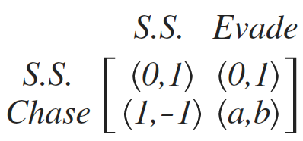
The Game Matrix

Slide 8
Test Conjecture
In order to test this conjecture I created a program to simulate the strategy pair, “Chase and Evade”

Slide 9
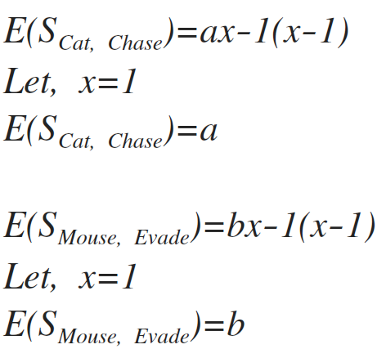
Logic of Conjecture as Applied

Slide 10
Results
After 25 I was able to find:
  Cat won, 0/25 portions of the time
    Hence, “a”
  Mouse won, 25/25 portions of the time
    Hence, “b”

Slide 11
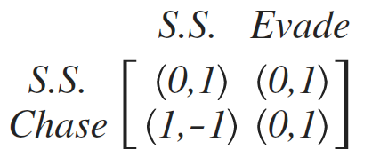
Results

Slide 12
Solution of the Game
It should be clear that there exist a case of dominance for the mouse.
  Evades doms S.S.
We should also take notice of the dominance in the cat’s strategies.
  Chase doms S.S.

Slide 13
Counter Arguments
The payoff data can only be as good as the models/simulations.
In this particular case the simulation is rather limited, and is clearly bias towards the mouse winning. The validity of which is questionable; yet still clearly demonstrates how it might be possible, with better simulations, to find payoffs via a similar process.

